Slide 1


Ocean Sort
Sorting Algorithm
By: Kyle Kucharski

Slide 2
Table of Contents
(1)
(2)
(3)
(4)
(5)
What is Ocean Sort?
Understanding the Mechanics of Ocean Sort
Implementing Ocean Sort
Visualizing Ocean Sort
Conclusion

Slide 3
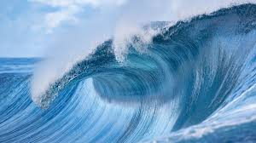

What is Ocean Sort?
Ocean Sort is a novel sorting algorithm that’s inspired from the natural process of ocean waves sorting sand along the shoreline.
Unlike traditional sorting algorithms which prioritize efficiency, Ocean Sort focuses on the visual and intuitive understanding of the sorting process.
By Simulating the natural flow of the ocean, this algorithm allows observers to see a physical representation of sorting, which makes it easier to understand.
The main purpose of Ocean Sort is to be educational. It’s designed to help observers interact with the sorting process in a way that emphasizes learning and comprehension over speed.
This approach makes Ocean Sort an ideal sorting algorithm for people that want to focus on the foundational concepts of data structures and algorithms.

Slide 4
Understanding the Mechanics of Ocean Sort
Initialization Phase
Ocean Sort begins by identifying the midpoint of the array, which serves as the central point. The initial wave range is set to half the length of the array, allowing the sort to impact the entire array from the central point outward.
Forward wave-motion Phase
Ocean Sort starts from the midpoint and moves outward in both directions. During this phase, each element is compared with its adjacent neighbor, and swaps are made if an element is greater than the one following it.
Retreat Phase
Once the wave-motion phase reaches the maximum range, the retreat phase begins. Here the comparison and swapping process reverses, moving from the ends of the wave range towards the midpoint.
Reduction of Wave Phase:
After completing a full forward and backward pass, the wave range decreases by one unit from each end
The algorithm repeats the wave like passes until no more swaps are needed during a full forward and backward pass.

Slide 5
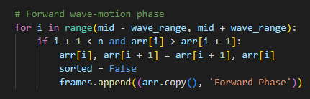
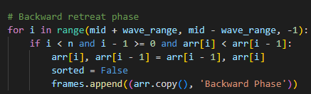
Implementing Ocean Sort
Ocean Sort can be implemented in many programming languages but I chose Python for its simplicity and powerful libraries.
Ocean Sort leverages uses array manipulation which keeps the implementation simple
The algorithms main function revolves around looping through the array with a dual phase approach, pushing elements outward and then refining their position inward, without the need for advanced memory management
Forward Wave Motion Phase
Retreat Phase

Slide 6
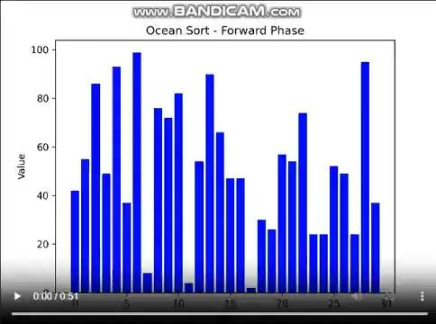
Visualizing Ocean Sort
This is a visual animation of Ocean Sort sorting a list. You can see how the sorting operation movies through a series of wave like motions.
Each frame in the animation represents a step in the sorting process, highlighting the forward and backward phases.
Elements gradually move towards their correct positions as the wave range decreases, which leads to a fully sorted array.

Slide 7
Conclusion
Educational Benefits
Ocean Sort offers a unique and visually engaging way to learn about sorting algorithms. By mimicking the natural process of ocean waves, it helps observers understand fundamental principles of sorting like element comparison and swapping.
Application Of Ocean Sort
Ocean Sort is ideal for use in learning scenarios like classrooms. It provides a demonstration tool that can help people understand algorithm design and data structures.
Future Prospects
There’s potential to improve Ocean Sort. Future development could involve creating interactive platforms where users can manipulate the wave parameters and observe the effects on the sorting process. I could also improve the visual animation.
Notes:
Personalization. By analyzing the user’s previous history and preferences, the system can recommend items that align with their tastes.
No cold start problem. Content based filtering also addresses the cold start problem which is a common issue in recommendation systems. When a new user joins, we have no data on them to provide accurate recommendations. However, with content based filtering, we could recommend movies or songs to new users based on the features of the movies or songs. As long as the movies or songs have defined features.
Privacy is another advantage content based filtering. Content based filtering focuses solely on the features of the movie or song therefore there’s no need to rely on user data ensuring privacy.
Finally, we learned that feature selection and the quality of dataset is important on the quality of recommendations.

